Slide 1

E-World
A little reading is the therapy a person needs sometimes

Slide 2
01
02
03
04
Contents:
LOGIN/SIGN-UP
HOME
Here you can create an account and register to the website
CATALOGUE
SAVED BOOKS
Here you can view all the books with different languages and generes
Here you can save all your favourite books for the future.

Slide 3

HOME
It consists of all the languages included and displays about the aim of the webpage and provides the contact information to the user for solving the problems and queries about the website

Slide 4
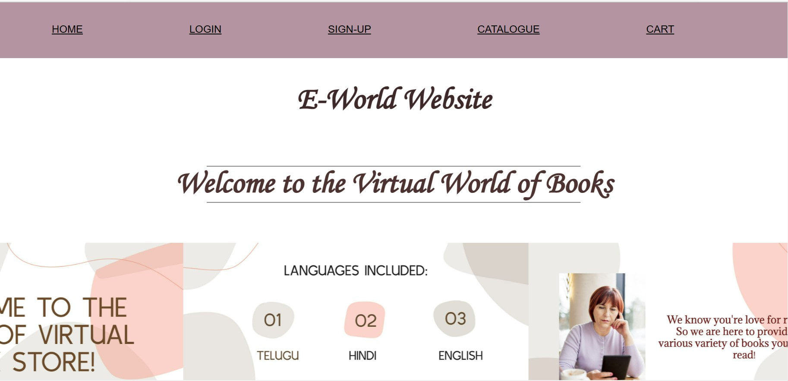

Slide 5
LOGIN/SIGN-UP
You could become a member of our E-World by signing-up and registering to the E-World website
(or)
If you are already a member then you can simply login to our website!

Slide 6
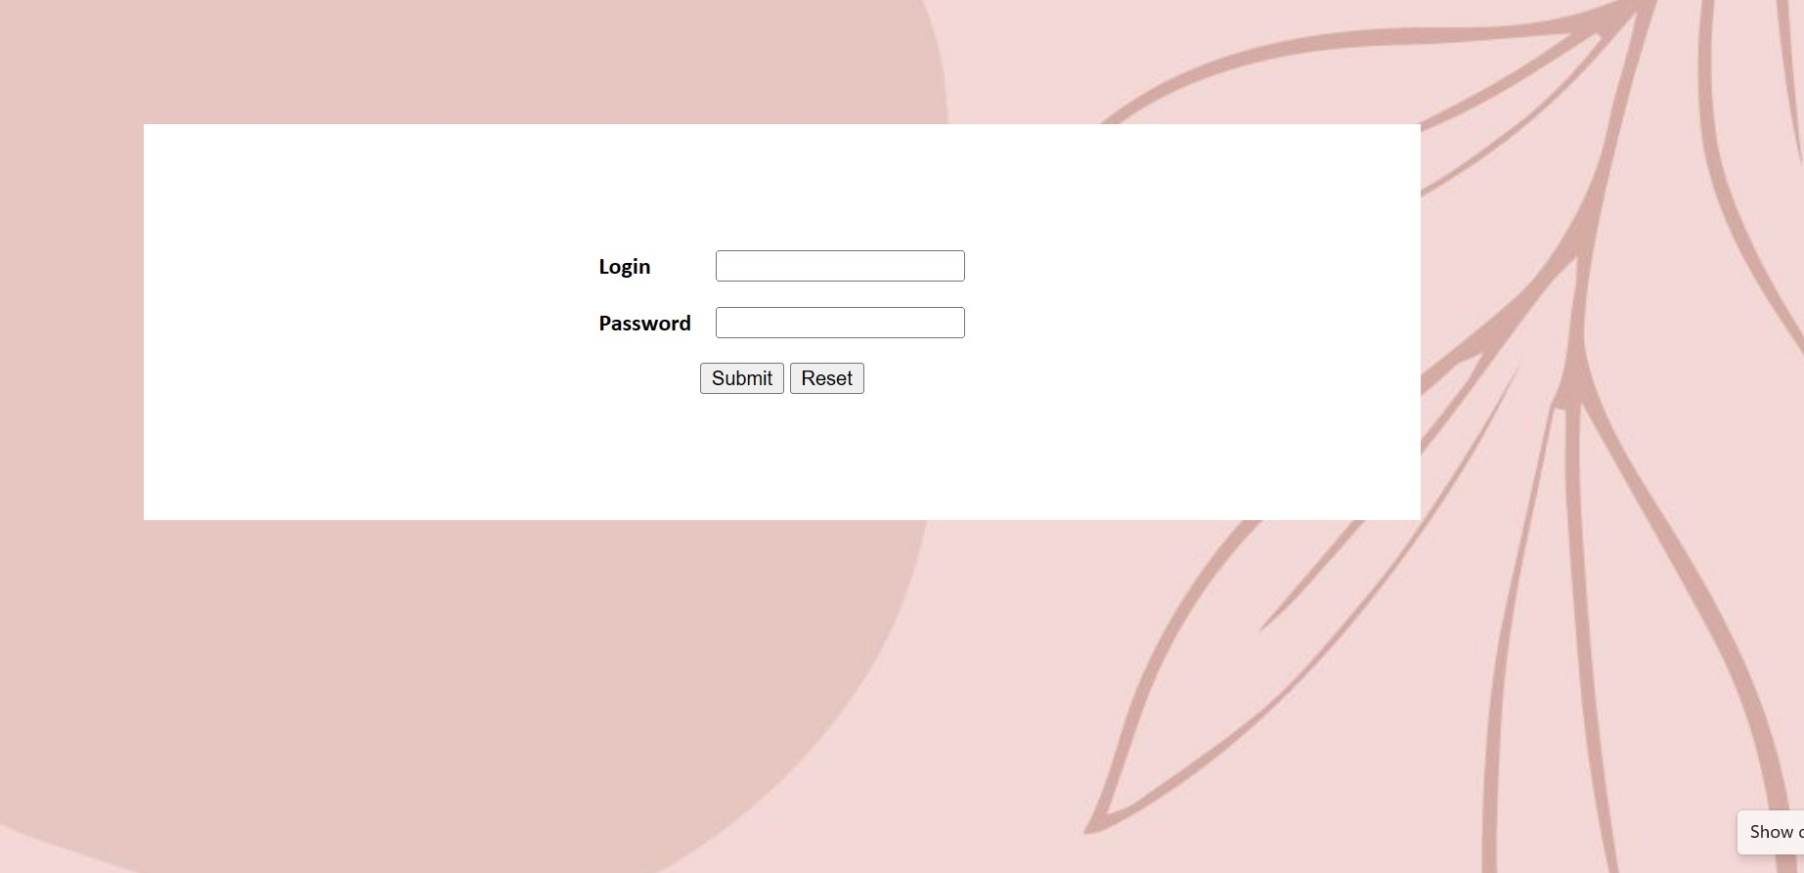

Slide 7
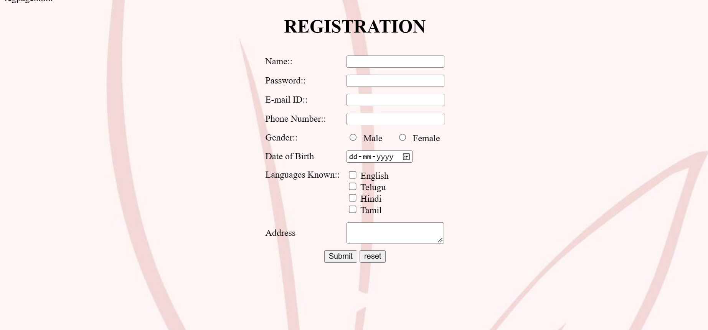

Slide 8
Catalogue
This is the section of the webpage where you can find all the books of consisting of different languages and genres

Slide 9
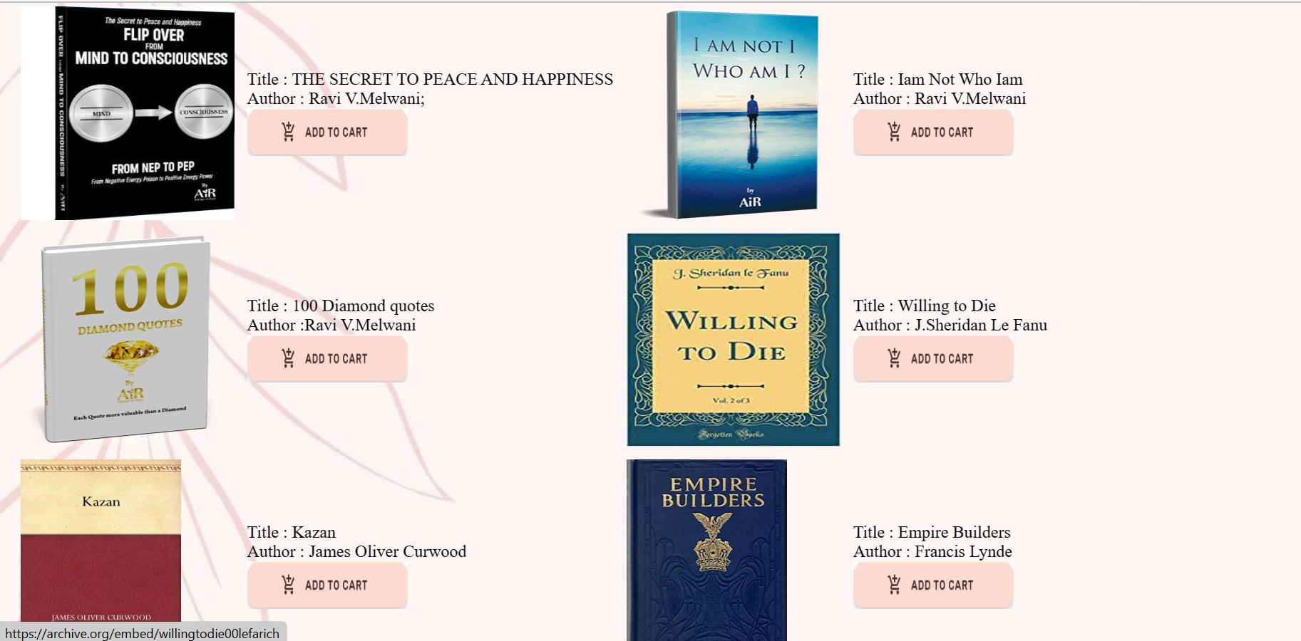

Slide 10
CART
We know that it would be difficult to remember the titles of all your favorite books and search for them in between so many books. So we provide an option called add to cart where you can easily add all your favorite books to the cart and save them and read them whenever you’d wish to…

Slide 11


Slide 12
Desktop Software

Slide 13

Let’s see a preview of E-word

Slide 14


Slide 15
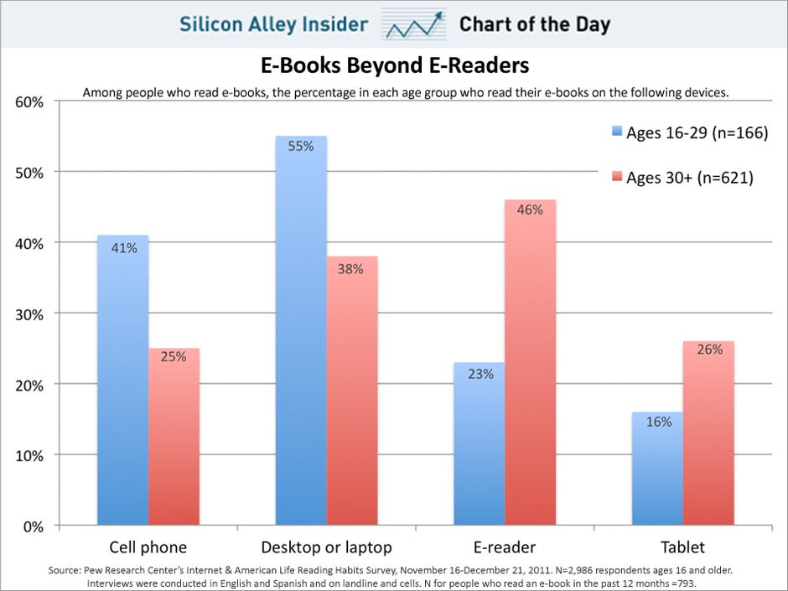

Slide 16

Our Team
Vamshi Reddy
Sathvik Reddy
2111CS020453@mallareddyuniversity.ac.in
2111CS020494@mallareddyuniversity.ac.in
Shanthi Priya
2111CS020503@mallareddyuniversity.ac.in
Sejal
2111CS020501@mallareddyuniversity.ac.in
Sreeja Reddy
2111CS020540@mallareddyuniversity.ac.in

Slide 17

Thanks!
Do you have any questions?
2111CS020540@mallareddyuniversity.ac.in
+91 9676645768

